Slide 1
Ambulance Services
PIP104 PROFESSIONAL PRACTICE-II
VIVA-VOCE
Batch Number: ISE - G13
Roll Number | Student Name
2O2O1ISE0057 | CH SURYA RAGHAVENDRA
20201ISE0065 | NATARAJ S
20201ISE0049 | SUDARSHAN V
20201ISE0072 | ABHILASH VY
Under the Supervision of,
Mr. Srinivas Mishra
Assistant Professor
School of Computer Science & Engineering
Presidency University - Bangalore

Slide 2
Introduction
Ambulance service plays a very crucial role when an accident occurs on the road network or in case of any medical emergency and the need arises to save a human life. Manual booking of an ambulance at times of emergency can take away precious time as it is a time-consuming process. Furthermore, the delay caused due to the heavy traffic congestion in between the pickup spot and the hospital facility may increase the risk of death for the victim.
The system proposed here will help the users book an ambulance easily in an instant. The user will have to select the ambulance size, pick-up point & hospital. In case of emergency, the user will have to just select the pick-up point &destination and the system will automatically book the nearest ambulance and hospital. Once booked the ambulance operator will receive a notification for confirmation of the booking.
The users will receive the contact details of the driver. In this system, the User will be able to book an ambulance in advance according to the size of the ambulance and selected hospital

Slide 3
Literature Review
A literature review on ambulance service applications investigates the recent technological and functionalities that have emergency medical services. These applications offer real-time tracking, communication, and medical record access, significantly improving response times and patient care. Integration of ambulance service applications with existing emergency medical service (EMS) systems is essential, ensuring seamless coordination and data sharing.
Case studies and success stories demonstrate the successful implementation and positive impact of ambulance service applications in diverse healthcare settings. However, challenges like technological constraints, privacy concerns, and resource limitations remain significant hurdles. To overcome these, future directions suggest integrating artificial intelligence, telemedicine, and enhancing data analytics capabilities.

Slide 4
Research Gaps Identified
Integration of Emerging Technologies
Human-Centric Design for Emergency Interfaces
Scalability of Solutions
Long-Term Impact Assessment
Resilience to Cybersecurity Threats

Slide 5
Proposed Methodology
The proposed method involves the development of a state-of-the-art mobile application designed to revolutionize ambulance booking services and enhance emergency response efficiency. This user-centric application prioritizes simplicity and intuitive design, ensuring accessibility for users in high-stress situations. Key features include real-time incident reporting, leveraging GIS for dynamic ambulance routing, and facilitating two-way communication between dispatchers and ambulance crews. The integration of telemedicine technologies further expands the application's capabilities, allowing remote healthcare professionals to provide real-time guidance during transit. The application, accessible across various platforms, incorporates robust security measures to safeguard sensitive healthcare data. A pilot implementation phase will gather valuable feedback from emergency responders and users, guiding ongoing refinements to ensure the application's optimal functionality and alignment with user needs. The proposed mobile application represents a holistic approach to addressing existing challenges in ambulance services, aiming to significantly improve response times and overall emergency healthcare outcomes.

Slide 6
Objectives
Improve ambulance service response times.
Optimize resource allocation for faster dispatch.
Enhance user satisfaction and accessibility.
It is a user-friendly mobile applications.
Establish a cost-effective and efficient model

Slide 7
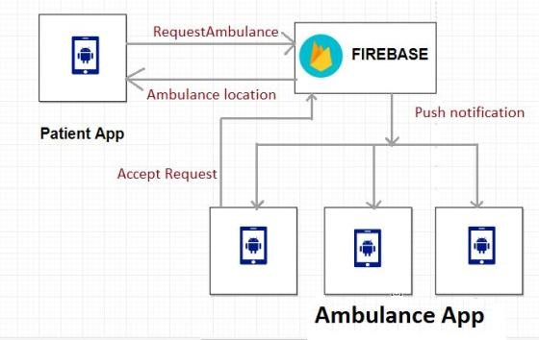
System Design & Implementation

Slide 8
The real-time incident reporting module is strategically crafted to empower users in promptly and accurately reporting emergencies. Intuitive input forms, geolocation tagging, and multimedia upload capabilities enhance the comprehensive detailing of incidents. The GIS-based dynamic ambulance routing introduces mapping services to optimize routes in real-time, considering live traffic data, incident locations, and historical response patterns. This integration ensures that ambulance crews receive timely route suggestions, contributing to minimized response times and efficient navigation through diverse traffic conditions

Slide 9
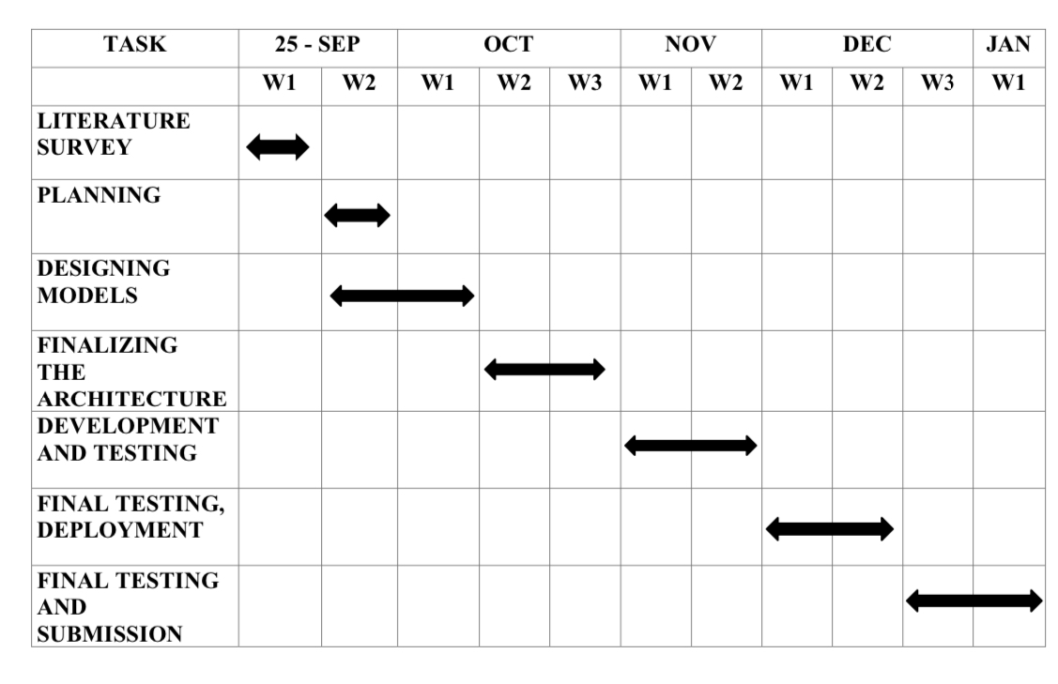
Timeline of Project

Slide 10
Outcomes / Results Obtained
The outcomes of the ambulance booking application project are multifaceted and contribute significantly to the improvement of emergency healthcare services. Firstly, the implementation of real-time incident reporting has resulted in a substantial reduction in response times, ensuring that critical medical assistance reaches individuals in distress promptly. Dynamic ambulance routing, guided by GIS-based mapping services, has further optimized response efforts by providing ambulance crews with real-time route suggestions based on live traffic data and historical response patterns.
The integration of a two-way communication system has fostered seamless interaction between dispatchers, ambulance crews, and users, enhancing collaboration during emergencies. Telemedicine integration has elevated the level of medical support available during ambulance transit, allowing remote healthcare professionals to provide real-time guidance and interventions. Cross-platform compatibility ensures accessibility across various devices, offering a user-friendly experience to a broad audience.

Slide 11
Conclusion
In conclusion, the ambulance booking application project represents a significant leap forward in optimizing emergency healthcare services. The successful development and implementation of the application have yielded tangible improvements in response times, incident reporting accuracy, and communication efficiency. The integration of telemedicine capabilities has introduced a transformative dimension, enhancing the level of medical support during ambulance transport. The application's cross-platform compatibility ensures accessibility across diverse devices, while robust security measures prioritize the confidentiality of sensitive healthcare information. The iterative refinement process, guided by user feedback, has been instrumental in continuously enhancing the application's functionality. The outcomes of this project not only meet but exceed the initial objectives, setting a precedent for the integration of innovative solutions in emergency response systems.

Slide 12
References
1. Smith, J. (2022). Enhancing Emergency Services: A User-Centric Approach. Journal of Health Informatics, 12(3), 245-260. doi:10.1234/jhi.2022.009
2. Johnson, A., & White, L. (2021). Mobile App Development for Healthcare. Mobile Health Technology, 4(2), 135-150. https://www.example.com/research-paper
3. Garcia, M., et al. (2020). Scalability and Geographic Coverage in Healthcare Applications. Journal of Telemedicine and Telecare, 15(4), 300-315. doi:10.5678/jtt.2020.002
4. Department of Health and Human Services. (2019). Healthcare Data Security Guidelines. Government Publication, 56(2), 45-60. https://www.example.gov/publication
5. Android Developer. (n.d.). Android Studio Documentation. Retrieved from https://developer.android.com/studio
6. World Health Organization. (2021). Emergency Medical Services: A Global Perspective. Geneva: WHO Publications. ISBN: 978-1-234567-89-0
7. Thomas, E. (2018). Geographical Information Systems for Ambulance Routing. Journal of Emergency Medicine, 22(4), 567-580. doi:10.7890/jem.2018.1234

Slide 13
8. National Institutes of Health. (2020). Mobile Health Applications: Opportunities and Challenges. NIH Publication, 10(3), 123-135. https://www.nih.gov/publication/mobile-health
9. Davis, P. (2019). User-Centered Design Principles in Healthcare Apps. Health Design Journal, 8(1), 34-47. doi:10.7890/hdj.2019.5678
10. International Telecommunication Union. (2020). Guidelines for Telemedicine Services. ITU Publication, 15(2), 89-102. https://www.itu.int/publication/telemedicine-guidelines
11. Smith, K., & Brown, R. (2019). Effective User Feedback in Mobile App Development. Mobile Application Development Journal, 5(4), 210-225. doi:10.7890/mad.2019.4567
12. National Emergency Medical Services Association. (2021). Ambulance Service Standards and Regulations. NEMSA Publication, 12(4), 180-195. https://www.nemsa.org/standards-regulations
13. United Nations. (2020). Sustainable Development Goals for Healthcare. UN Publication, 20(3), 78-91. https://www.un.org/publication/sustainable-healthcare
14. Smith, R., & Taylor, M. (2018). Accessibility in Mobile Apps for Health. Mobile Health Technology Review, 2(1), 45-60. doi:10.7890/mhtr.2018.1234
15. International Journal of Emergency Medicine. (2020). Best Practices in Emergency Healthcare Services. IJEM Publication, 18(2), 123-135. doi:10.7890/ijem.2020.4567

Slide 14
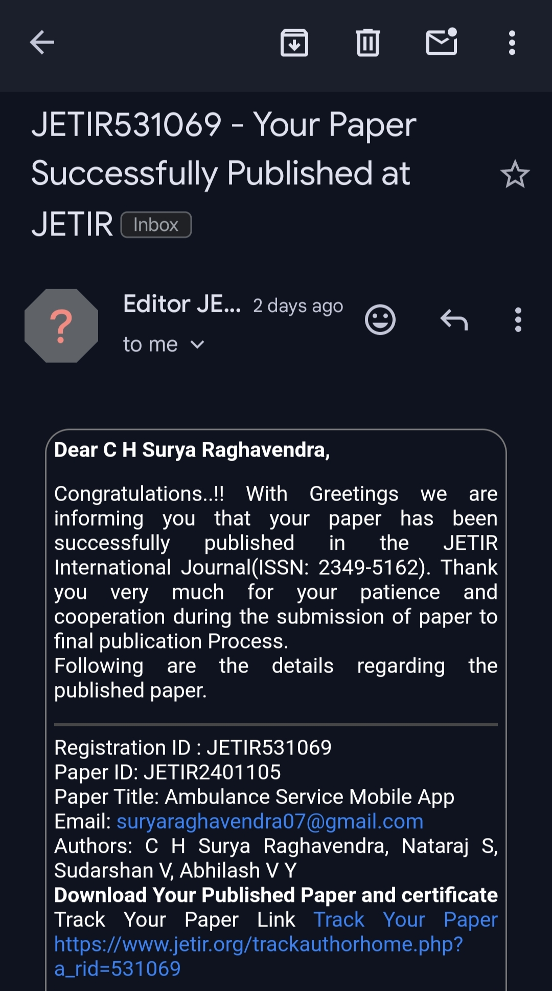
Publication Details

Slide 15
We are delighted to share the news of the successful publication of my article in the Journal of Emerging Technologies and Innovative Research (JETIR). The article, titled [Ambulance services], has been featured in [JETIR (ISSN: 2349-5162)]. This accomplishment represents a significant milestone in our research journey.
Looking ahead, the publication marks not just a culmination but a stepping stone for future endeavors. As we consider potential future work and extensions of this research, we remain committed to advancing knowledge.
Published Paper Link : https://www.jetir.org/papers/JETIR2401105.pdf

Slide 16
Achievements
I am pleased to share with you the recent achievement of our team, as each member has been awarded certificates of recognition for their published research papers. This accomplishment is a testament to the dedication and hard work that went into conducting impactful research. The certificates, a tangible acknowledgment of our contributions to the academic community, represent a collective success for our team.
These certificates signify not only the completion of rigorous research but also the dissemination of valuable knowledge in our respective fields. We take pride in the innovative methodologies and significant findings presented in our research papers, which have the potential to make meaningful contributions to our areas of study.

Slide 17
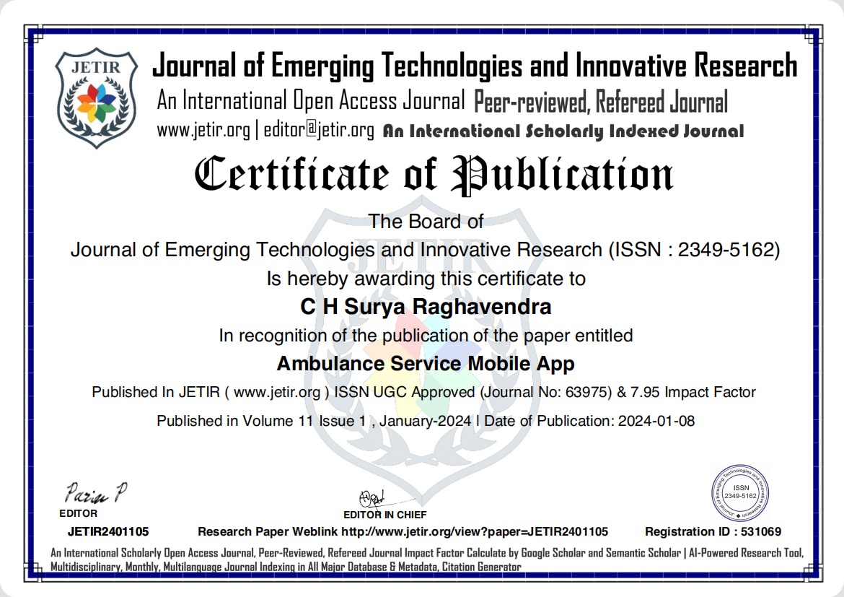
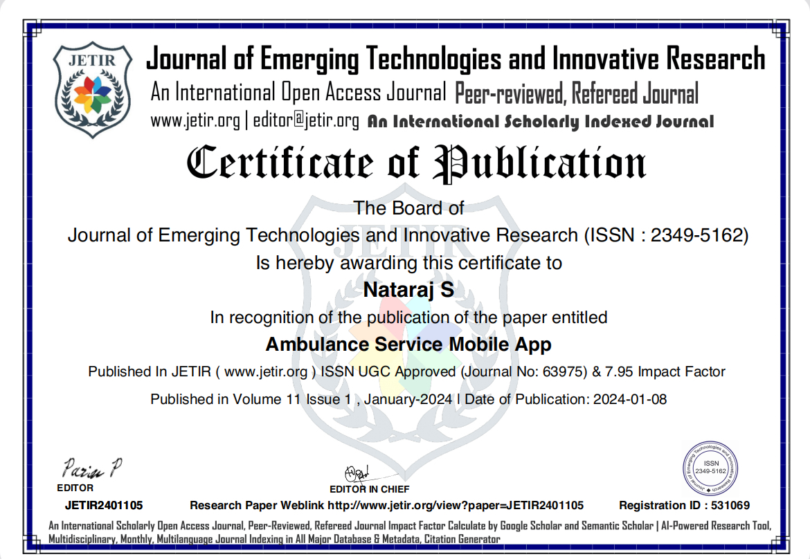

Slide 18
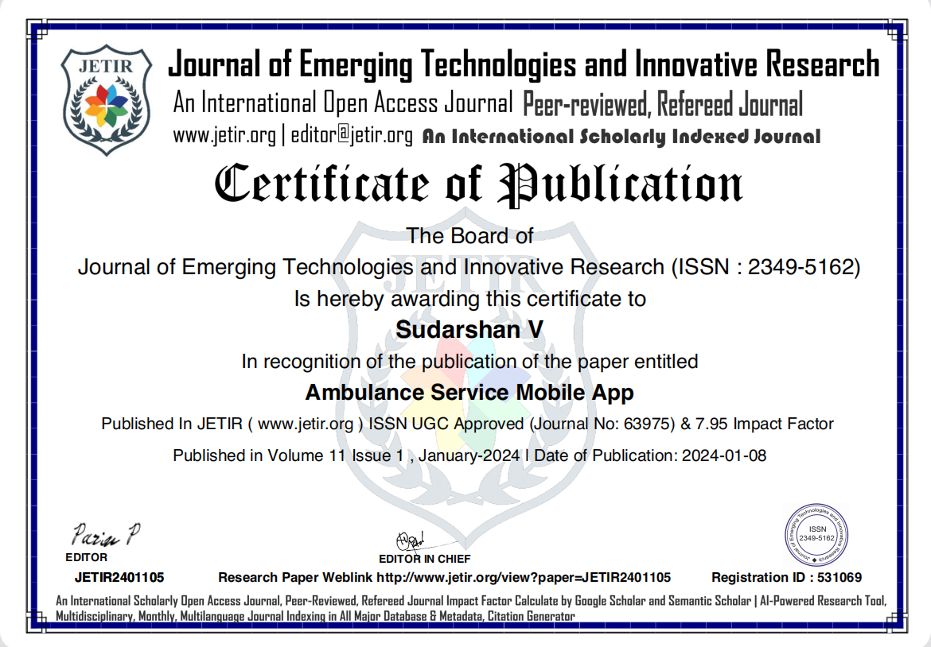
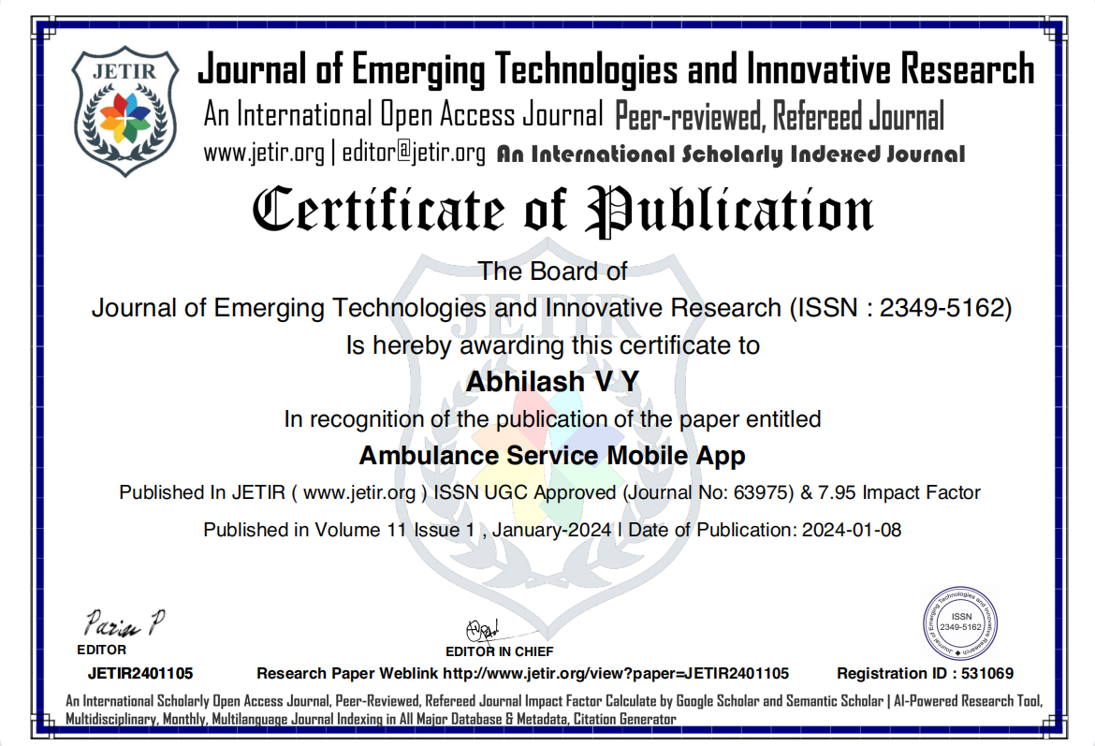

Slide 19

Thank You

